Slide 1
Customer Prediction

Slide 2
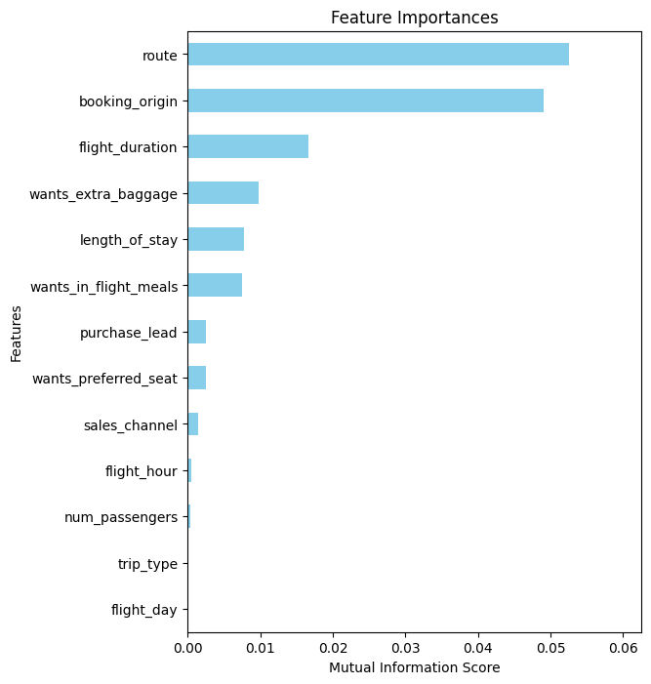
Results
The main factor that influences whether a customer books a ticket is the route.
While purchase lead (time between purchase and departure) does have impact, it is still lower than other factors.
Model was built to predict customer behaviour, reaching 84.79% accuracy. However, the AUC score < 0.5, suggesting that the model requires more improvement

